Slide 1
Why Snowflake? Cloud Data Warehousing?
Notes:
Prerequisites:
"Basic knowledge of SQL, and database concepts and objects“.
"Familiarity with JSON semi-structured data".

Slide 2


speakers
Dinesh Kumar P Product Manager, Kissflow
Prashanth K
Tech Lead, Kissflow

Slide 3
Agenda
Demystify what makes a (cloud) Data warehouse different by its core architecture from Database, Data Lake.
Cloud data warehouse.
What is Snowflake?
Why Snowflake?
Live demo - Auto inject Twitter data into Snowflake using Snowpipe and do real-time analysis in Power BI.

Slide 4
Database Data warehouse Data Lake
- Demystify.
- Best fit scenarios to choose one.
Notes:
This is a crazy and slightly confusing time in the data architecture space. More and more companies are shifting towards data lakes, yet the traditional data warehouse and database continues to provide value, as it has for decades. Now to add that, we have this increasingly popular lakehouse and delta lake concept. The concepts I discuss here will be common that would fit for deciding over data services in Azure as well.

Slide 5
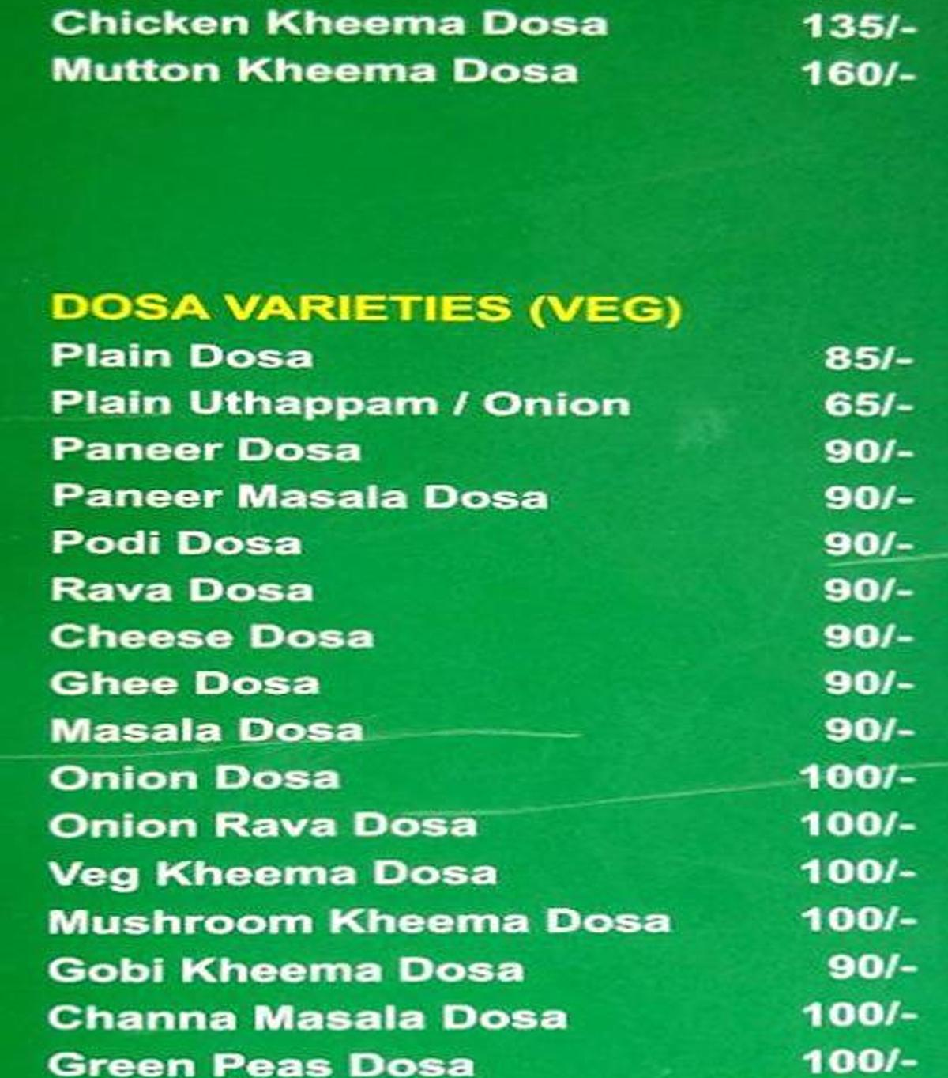
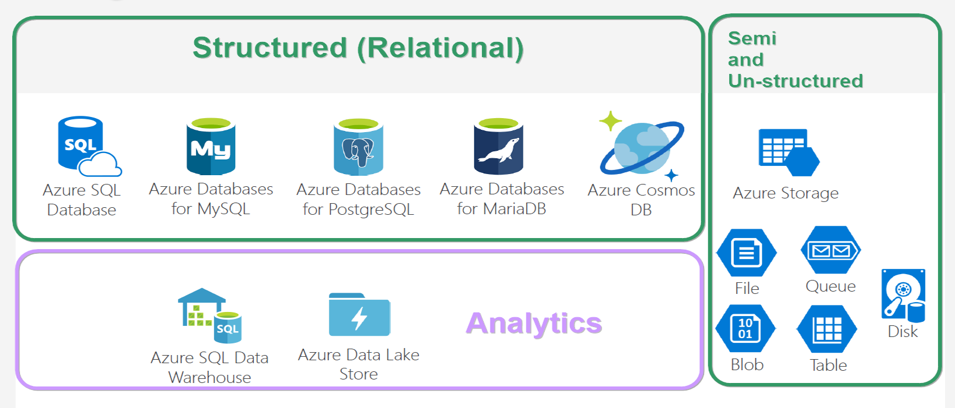
Database VARITES
Notes:
And looking at this, does both give same feeling? ☺

Slide 6
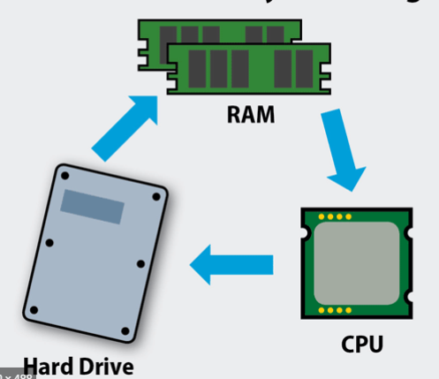
Database
* Co-location of Compute & Storage.
* Schema on Write.
* Recommended for,
- Structured data of less than a TB,
- Purpose - OLTP.
* Not recommended for,
- Ad-hoc analytics.
- More dependency in sharding.

Slide 7
DBMS storage models
Notes:
NoSQL db – data storage model types –
* Document - Frequent schema changes with sub-tables need. (Mongo DB)
* Graph – Neo4j.
* Key-value - Redis.
* Column-oriented – Hbase, Cassandra.

Slide 8
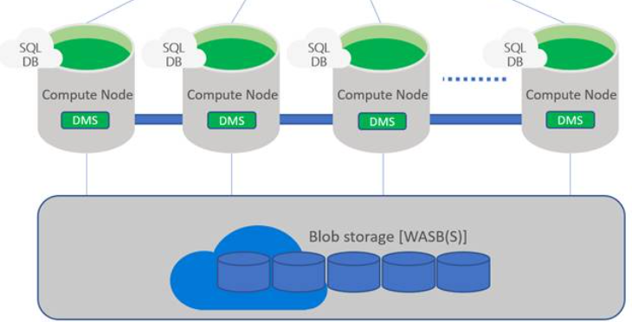
Data warehouse
* Separation of Compute & Storage.
* Schema on Write.
* Recommended,
- If you know metadata & format of analytics to be done.
- ML/AI not needed much. Query not over large dataset.
- Expose out; allowing customers to analyse.
* Not recommended,
- Unstructured data like image and video.
- Semi-structured with multiple levels.

Slide 9
Data lake
* Separation of Compute & Data.
* Schema on Read.
* Recommended,
- Must store all types of data of any size.
- Query over large datasets.
- Store now; play later as and when you need. (Internal analytics).
* Not recommended,
- Data stored should be readily available for analytics upon which users would create reports.

Slide 10
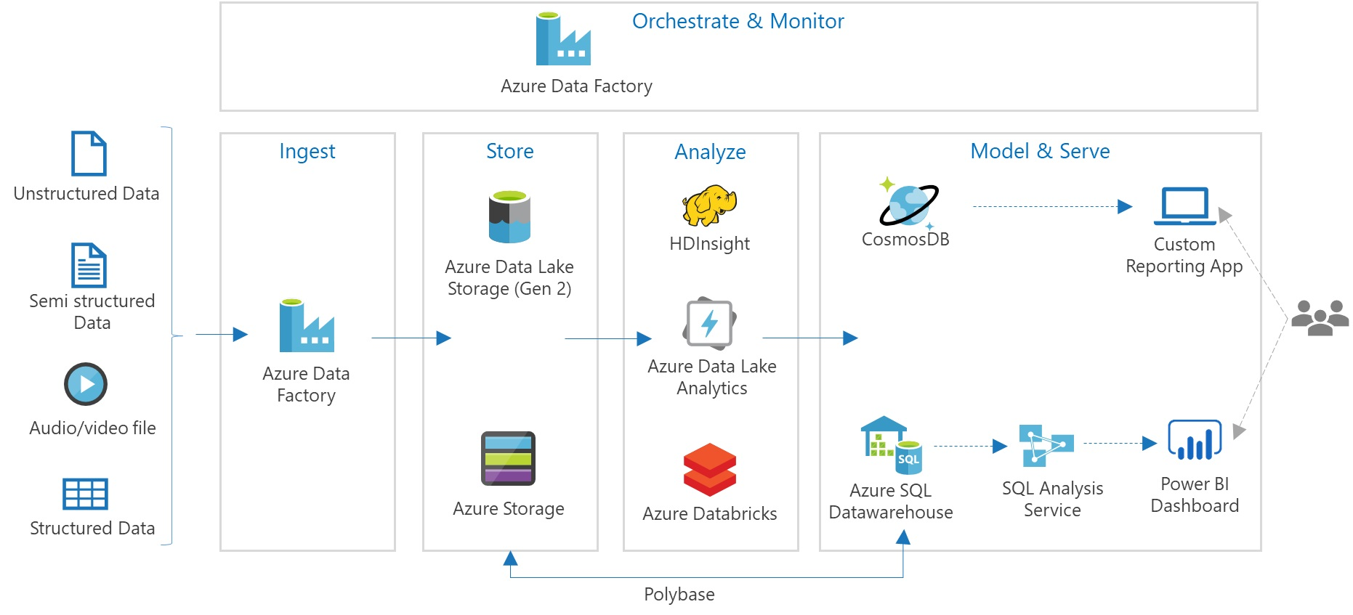
Data lake

Slide 11
OLTP vs OLAP

Slide 12
analytics db & transaction db
Characteristic | OLAP | OLTP
Data | Historical data in column format. Read more and rare writes. | Operational data in row format. Both read and write.
Query pattern | Large no of records included with aggregations, complex joins, filter, drill down, slice, dice. | Small no of records fetched by key, mostly simple joins, CRUD.
Users | Analyst, decision makers. | Application builders, Backend developers.
Providers | Snowflake, Big Query, Redshift, Teradata vantage. | SQL Server, Mysql, Postgres, Azure Cloud SQL, Google Cloud Spanner, AWS RDS.

Slide 13
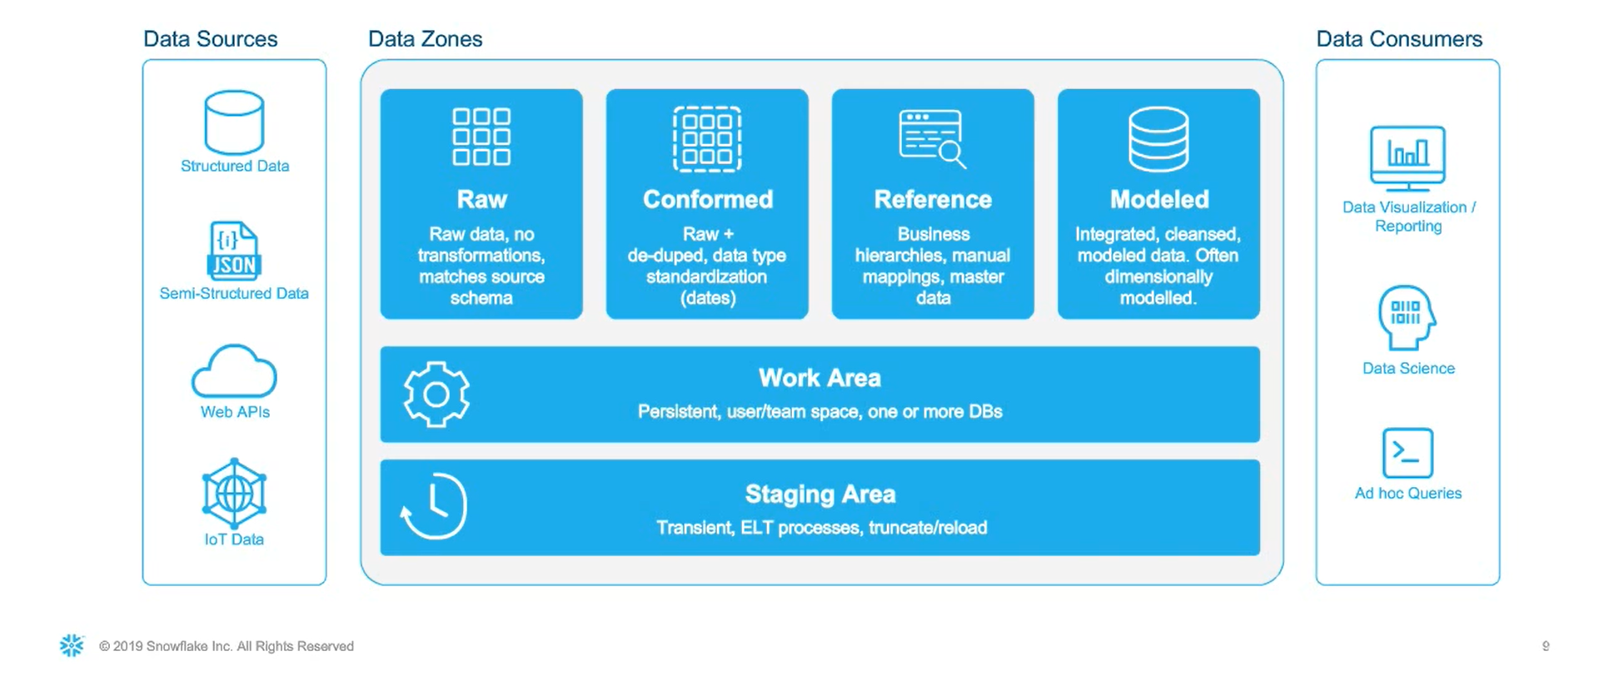
Hybrid data architecture

Slide 14
SNOWFLAKE data platform
Data Warehouse as a service

Slide 15


Slide 16
Cloud data warehouse
* Azure Synapse Analytics (Azure SQL Data warehouse)
* Snowflake
* Amazon Redshift
* Google BigQuery

Slide 17
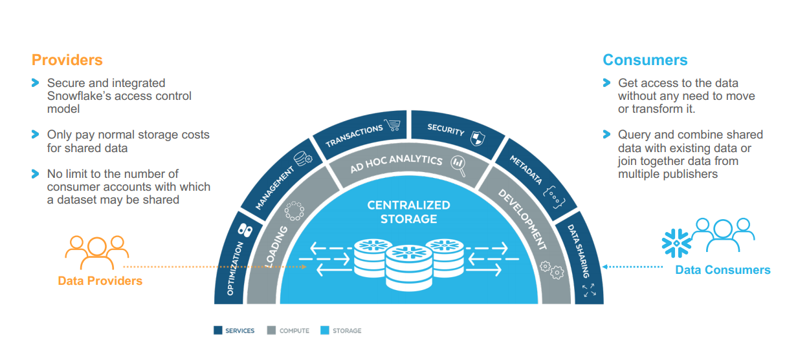
Snowflake ARCHITECTURE
Notes:
Store all your data.
Extreme simplicity.
Full support for ACID transactions with read consistency.
ANSI SQL, RBAC.

Slide 18
What makes Snowflake unique
* Auto scaling.
* Snowpipe - Serverless concept for data loading instead of using VWH + copy command in SF itself.
* Zero Copy Cloning - Prod/Dev/Test - Assign cloned tweets table to testing team.
* Schema on read via variant datatype. Analyse semi-strcutured data like json, avro, parquet – tweets_view.
* Time travel.
Notes:
Traditional data warehouses cannot do these things easily.

Slide 19
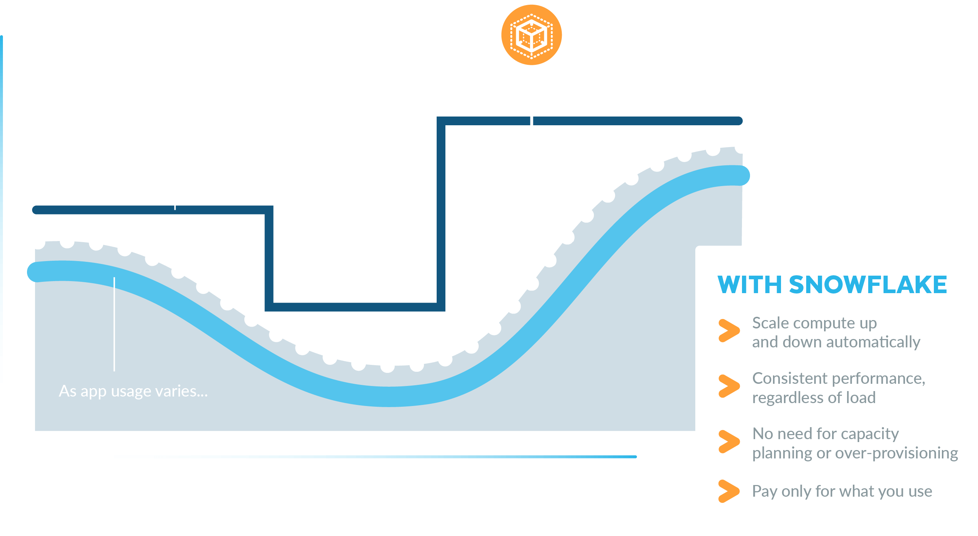
Unlimited + instant auto scaling

Slide 20
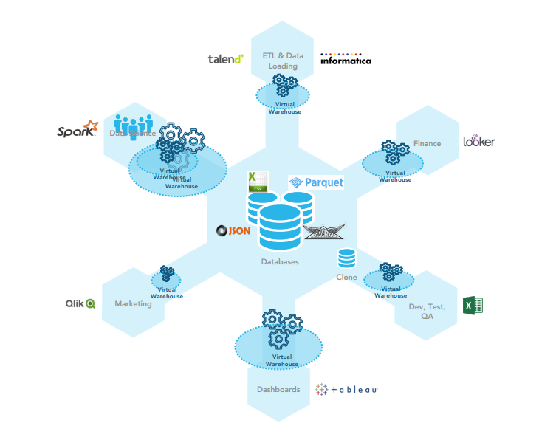
Multi-cluster shared data architecture

Slide 21
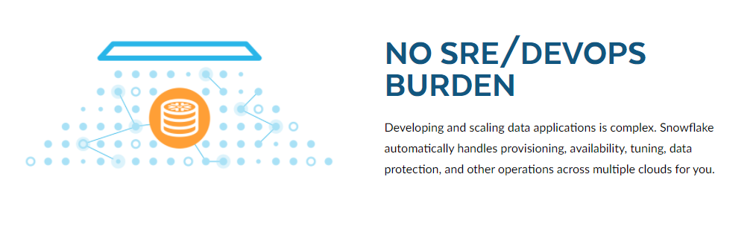
No sre/devops burden

Slide 22
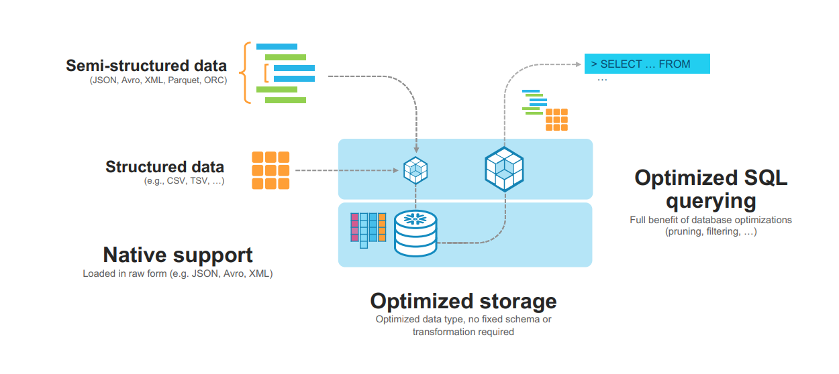
SEMI-structured data

Slide 23
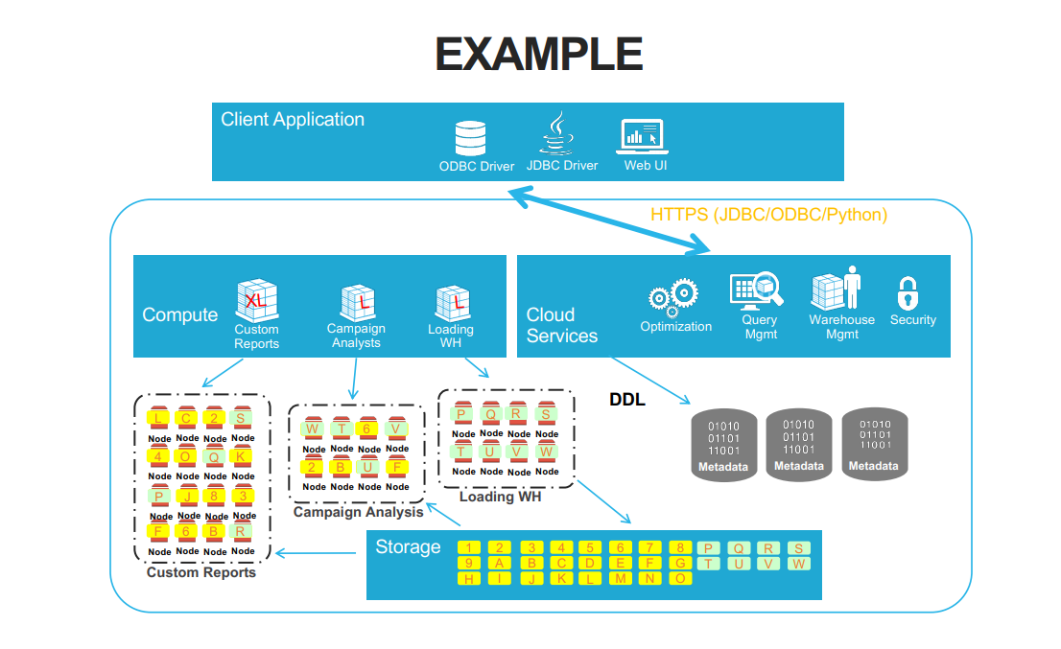
Accessing snowflake

Slide 24
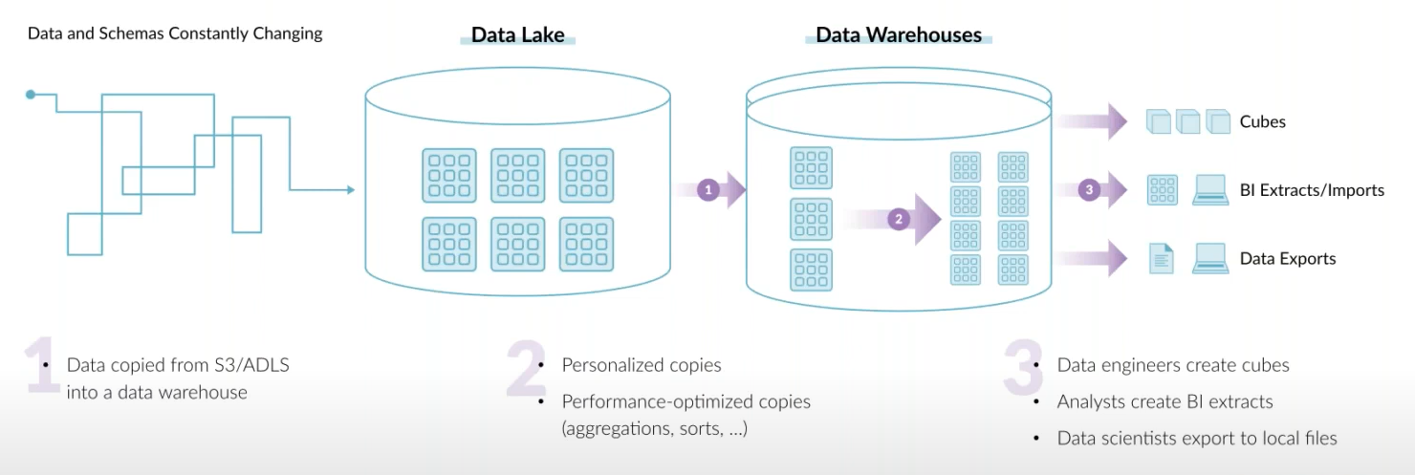
End goal of a data architecture
* Architect so that copying data gets lesser across teams.
* Allow USER to take SMART decisions.
* Define goal based on customers need.

Slide 25

Questions ??

